Slide 1
Calculating WACC for Avenue Super Mart Formulas Used WACC = [(Weight of Equity * Cost of Equity) + (Weight of Debt * Cost of Debt)] Cost of Equity = Risk Free Rate (Rf) + Levered Beta (β) * Equity Risk Premium (Rm-Rf) Unlevered Beta = Covariance (Ri, Rm)/Variance (Rm) Risk Free Rate (Rf) = Returns from a 10 Year Bond (Hard-Coded; Source – Investing.com) Levered Beta (β) = Comparable Median Unlevered beta * [1+(1-Tax Rate)*Target Debt/Equity] Total Market Return (Rf) = Average Returns + Dividend Yield (Hard-Coded) Cost of Debt = Pre-Tax Cost of Debt – Tax Rate Pre-Tax Cost of Debt = (Total Interest/Total Debt)*100 Tax Rate = Hard-Coded (Long Term Tax Rate) Weight of Debt = Target Debt = Average Debt/Capital Ratio for comparable companies. Weight of Equity = 100 – Weight of Debt

Slide 2
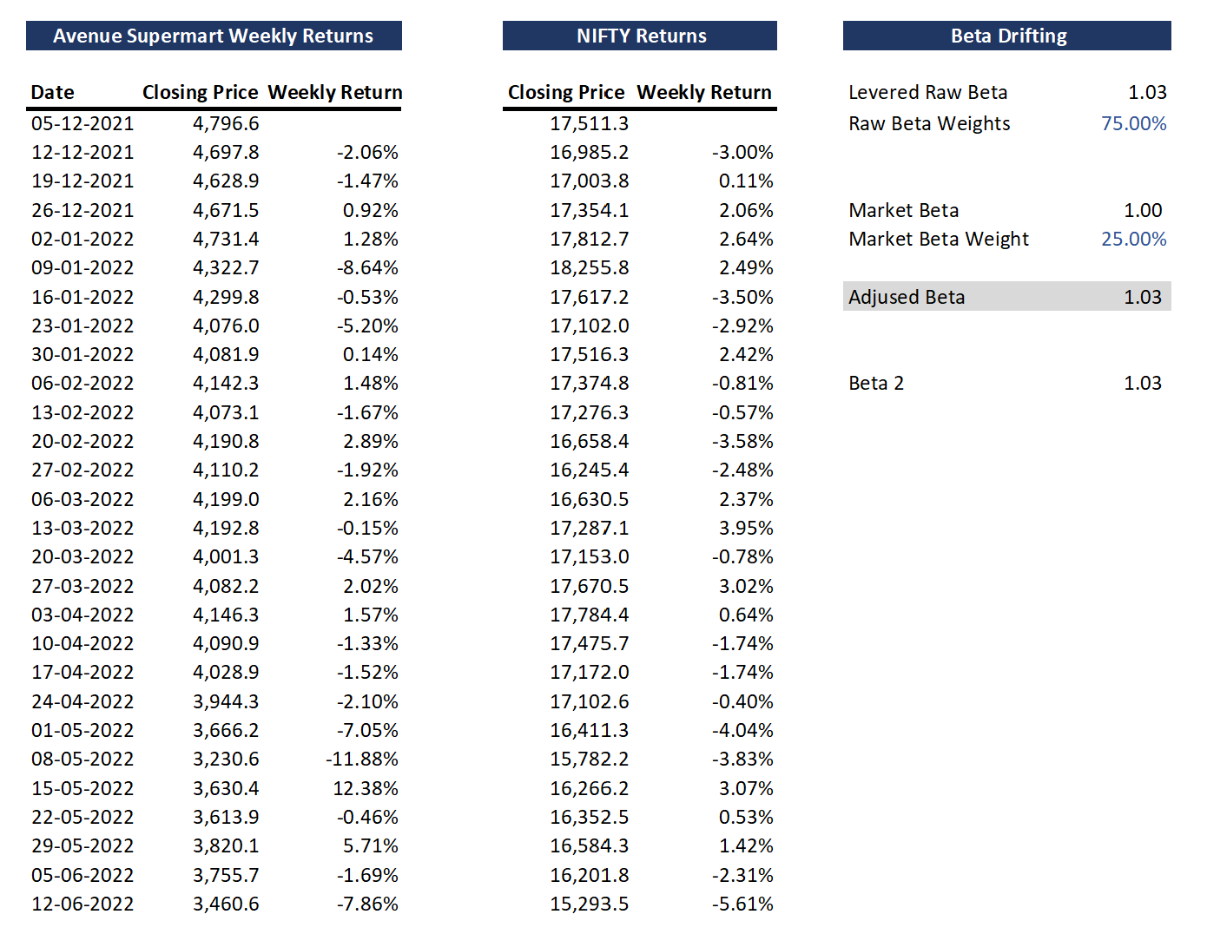
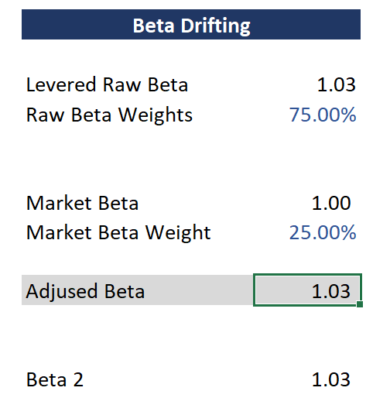
Step 1: Calculating Unlevered Beta
Historical Data from Yahoo Finance
Beta 2 = Levered Raw Beta =
Covariance (Avenue Supermarket Weekly Returns, NIFTY Weekly Returns)/ Variance (NIFTY Weekly Returns)
Adjusted Beta = Unlevered Beta =
(Levered Raw Beta*Raw Beta Weight) + (Market Beta*Market Beta Weight)

Slide 3
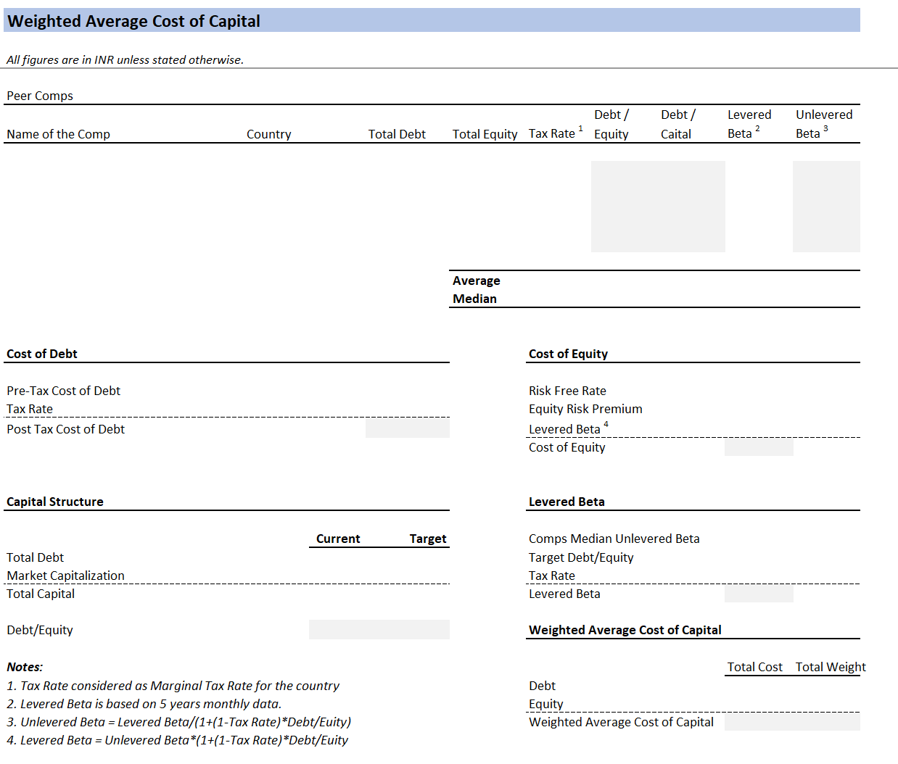
Step 2: Creating a Template to Calculate WACC

Slide 4
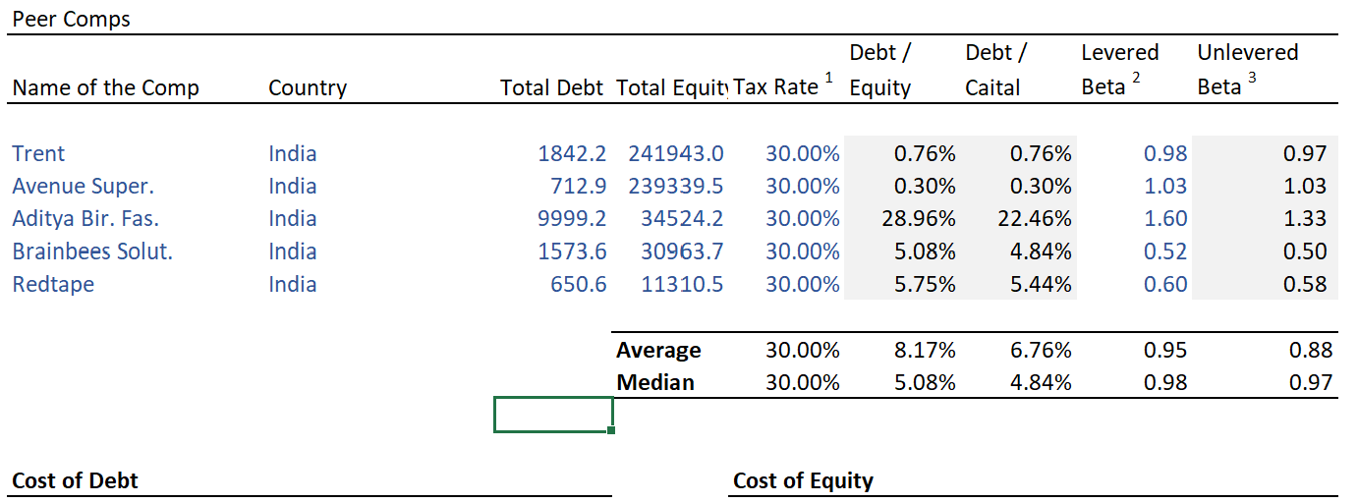
Step 3: Populating the “Peer Comp” Section
To gather information on comparable companies:
Screener.com > Avenue Super Mart > Peers (Retail) > Filters Added (Debt, Market Cap, Debt/Equity) > Sort by highest Market Cap > Copy & Paste top 5 companies to Excel.
Tax Rate – Hard Coded
Debt/Capital = Total Debt/(Total Debt + Total Equity)
Levered and Unlevered beta can be calculated for each of these companies using the method in slide 2.

Slide 5
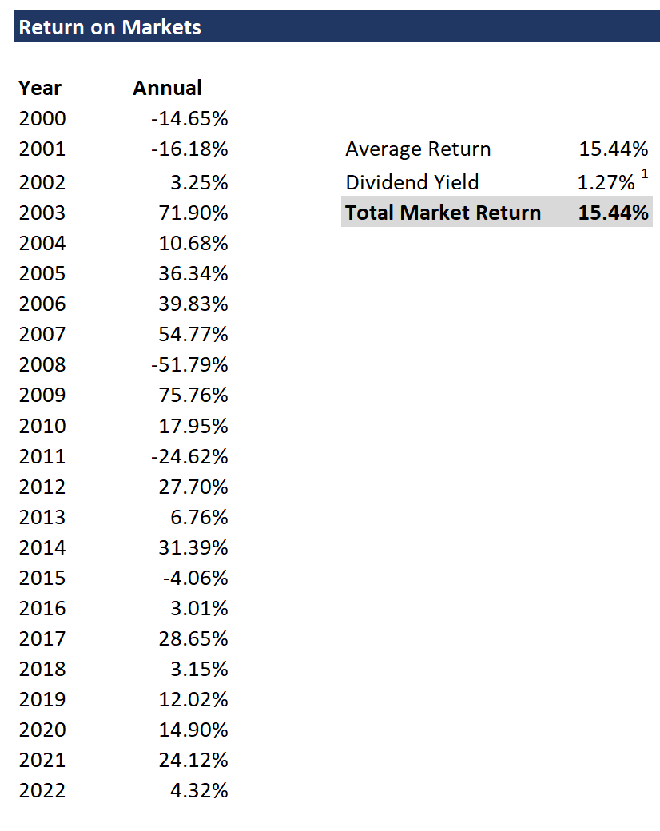
Step 4: Calculating Returns on Market (Rm)

Slide 6
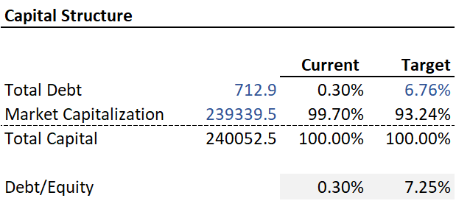
Step 5: Populating “Capital Structure”
Total Debt and Total Equity (From Peer Comp) (For Avenue Super Mart)
Current Debt Weight = Total Debt/ Total Capital
Current Equity Weight = Total Market Cap/Total Capital
Target Debt = Average Debt/Capital (From Peer Comp)
Target Equity = 100 – Target Debt
Target Debt/Equity Ratio = Target Debt/Target Equity

Slide 7
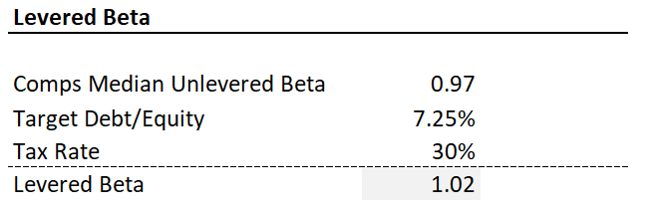
Step 6: Populating “Levered Beta”
Comps Median Unlevered Beta (From Peer Comp)
Target Debt/Beta (From Capital Structure)
Tax Rate (Hard-Coded)
Levered Beta =
Comps Median Unlevered Beta *[1+(1-Tax Rate)* Target Debt/Beta]

Slide 8
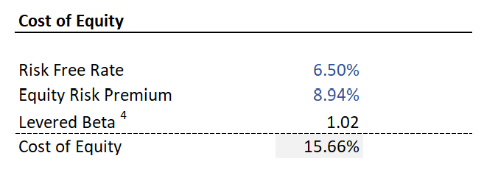
Step 7: Populating “Cost of Equity”
Risk Free Rate = Return on 10 Year Bond (From Investor.com India)
Levered Beta (From Levered Beta)
Equity Risk Premium (Rm-Rf)
Rm = Slide 5
Rf = Risk Free Rate
Cost of Equity = Risk Free Rate + Equity Risk Premium * Levered Beta

Slide 9
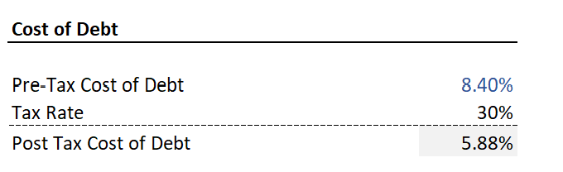
Step 8: Populating “Cost of Debt”
Pre-Tax Cost of Debt = Total Interest/Total Debt (From Screener.com for Avenue Super Mart)
Tax Rate = Hard-Coded
Post Tax Cost of Debt =
Pre-Tax Cost of Debt - Tax Rate

Slide 10
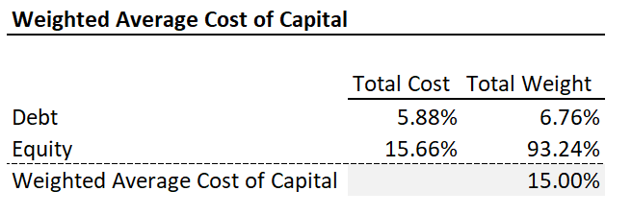
Step 9: Populating “Weighted Average Cost of Capital (WACC)”
Cost of Debt
(from cost of debt)
Cost of Equity
(from cost of equity)
Weight of Debt
(From capital structure)
Weight of Equity
(From capital structure)
WACC =
(Cost of Debt * Weight of Debt) + (Cost of Equity * Weight of Equity)

Slide 11
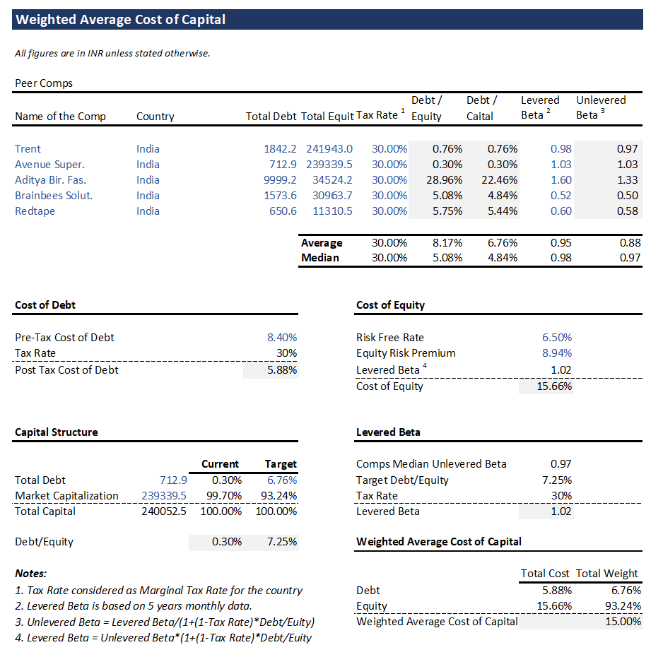
Step 10: Final Output
WACC for Avenue Super Mart

